Slide 1
Full Text Indexing! or…..
What is that service I never turn on?
↑ Old School

Slide 2
About Me
Eric Blinn
Database Services Manager
TMW Systems / Trimble
Cleveland, Ohio
SQL Server user since 2003
https://ericblinn.com
@SQL2TheSequel
https://www.linkedin.com/in/ericblinn
2 |

Slide 3
Agenda
What is it?
How does it work?
How do you make a FTI?
How do you call it?
General Housekeeping

Slide 4
What is it?
Full text indexing is a companion service to SQL Server based on Windows file search algorithm
The service breaks text fields into individual words for faster searches
Been available in some form since SQL Server 2000
Starting in 2012 the service added delimiters and more powerful search abilities
4 |
5/6/2017 |
Full Text Indexing

Slide 5
Limitations
Updates are asynchronous
Tables must have single column unique index
Full text indexing will help you find words or starts of words in text columns
Full text indexing will not help you find parts of words.
5 |
5/6/2017 |
Full Text Indexing

Slide 6
How does it work?
Consider this sampling from a table of books
How could we find all books that have the word “Mars” in the title?
How could we find all books authored by Mr. Moose?
ID ᵖᵏ | Title | Author
1 | Backups are overrated | Willie Makit
2 | SQL is from Mars, Azure is from Venus | Bullwinkle Moose
3 | The DBA on the Train | Rocky Squirrel
6 |
5/6/2017 |
Full Text Indexing

Slide 7
How does it work?
The Full Text indexing service makes a table, called a catalog, where each word gets its own row.
Table | docid | Column | Word | Sequence
Books | 1 | Title | Backups | 1
Books | 1 | Title | are | 2
Books | 1 | Title | overrated | 3
Books | 1 | Author | Willie | 1
Books | 1 | Author | Makit | 2
Books | 2 | Title | SQL | 1
Books | 2 | Title | from | 2
Books | 2 | Title | Mars | 3
Books | 2 | Title | Azure | 4
Books | 2 | Title | from | 5
Books | 2 | Title | Venus | 6
Books | 2 | Author | Bullwinkle | 1
Books | 2 | Author | Moose | 2
7 |
5/6/2017 |
Full Text Indexing

Slide 8
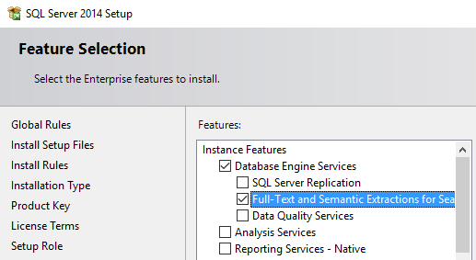
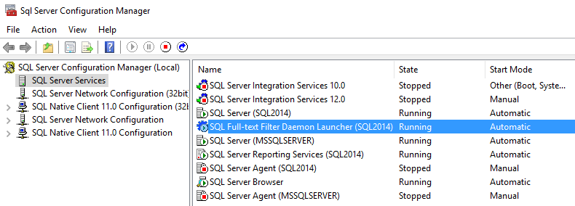
Setting it up
Install it
Start it
8 |
5/6/2017 |
Full Text Indexing
Notes:
Add installation screenshot

Slide 9
How do you make a FTI?
Choosing a candidate table
Find a table with a single column unique index
That table must also include at least text column such as [N]CHAR or [N]VARCHAR (MAX is ok) to be indexed
From those candidate columns, choose a column or group of columns to be part of the Full Text Index
Create a catalog
The catalog is the “table” that will hold the words.
Best practices suggest making one catalog per table
9 |
5/6/2017 |
Full Text Indexing

Slide 10
Create the Index
This is where we tell the FTI service that it needs to consider a new table and/or column.
Options
Build now or later?
Build now will kick off the asynchronous catalog build immediately. Alternately, the index can be defined, but not built.
Continuous updates vs scheduled
The index can be set to automatically update upon data changes or set to only be done manually, likely via an Agent job.
The size of the table/columns along with the business requirements will dictate those decisions.
10 |
5/6/2017 |
Full Text Indexing

Slide 11
Let’s see that in action!!
11 |
5/6/2017 |
Full Text Indexing

Slide 12
Are we ready to use it?
SQL Server provides a series of DMVs to monitor and manage the creation of the FTIs.
12 |
5/6/2017 |
Full Text Indexing

Slide 13
How do you use it?
Full text indexing introduces us to 4 new keywords.
 | Exact Matches | Fuzzy Matches
Boolean (WHERE) | CONTAINS | FREETEXT
Table Valued (FROM) | CONTAINSTABLE | FREETEXTTABLE
13 |
5/6/2017 |
Full Text Indexing
Notes:
Mention some of the extra functions that can be added to CONTAINS to make it act a little more like FREETEXT

Slide 14
General Housekeeping
The catalogs are stored in the MDF and will affect the MDF size.
FTIs are part of any normal DB backup routine.
There are no special permission requirements for FTIs.
You can (and should) reorganize a FTI, especially after a full build.
Full text indexes can be made on File Tables
14 |
5/6/2017 |
Full Text Indexing
Notes:
As the FTI service is based on the windows file search, it is capable of searching certain blob files like PDFs that are stored in a FileTable

Slide 15
Join us next time for…
15 |
5/6/2017 |
Full Text Indexing
Notes:
Note to self: Think of joke for this slide.

Slide 16
Questions?
Thank you for coming!!
Please fill out an eval form
https://ericblinn.com
@SQL2TheSequel
https://www.linkedin.com/in/ericblinn
16 |
5/6/2017 |
Full Text Indexing

